Slide 1
Victory Heights Community Council
2021 Report

Slide 2
Hallmark Campaigns

Slide 3
Eight Utility Box Works of Art
Notes:
Utility Box Artwork - Opened May
$10k through Dept of Neighborhoods
Raised nearly $800 locally
Supported eight local artists from very different backgrounds

Slide 4
Food Truck Fridays
Notes:
Food Truck Fridays – bring neighbors together, support local businesses, new food during so much cooking from home

Slide 5
Neighborhood Survey
Notes:
Neighborhood Survey – learn the priorities of our residents and act upon them.
Digital survey
Task Force to evaluate
Public reporting
Committee heads to lead
Taking action

Slide 6
Mayor Mondays
Notes:
Mayor Mondays

Slide 7
Notes:
Teen Feed

Slide 8
Social Events

Slide 9
Spring Scavenger Hunt
Notes:
Scavenger Hunt

Slide 10
Inaugural Fall Chili Cook-off
Notes:
Chili Cookoff

Slide 11
Notes:
Yard Sale

Slide 12
Craft Fair
Notes:
Craft Fair

Slide 13
Monthly Meeting with Interesting Speakers
Notes:
Monthly Meetings with Featured Speakers

Slide 14
August Silly Walk
Notes:
Silly Walk

Slide 15
Communications

Slide 16
Facebook Audiences
Notes:
Consolidated Facebook groups and grew audiences

Slide 17
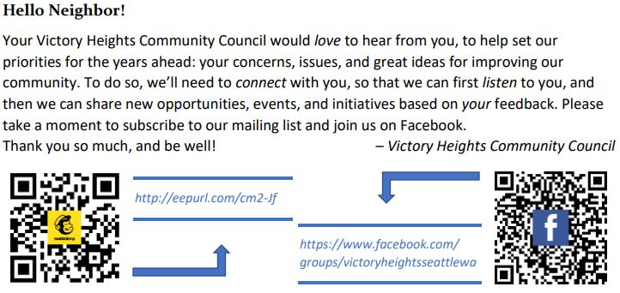
Building Communication Communities
Notes:
Spring physical flyer campaign to grow email and Facebook

Slide 18
Community Message Board
Notes:
Established Community Message Board policies and energized

Slide 19
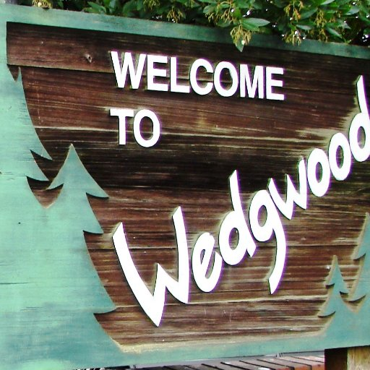
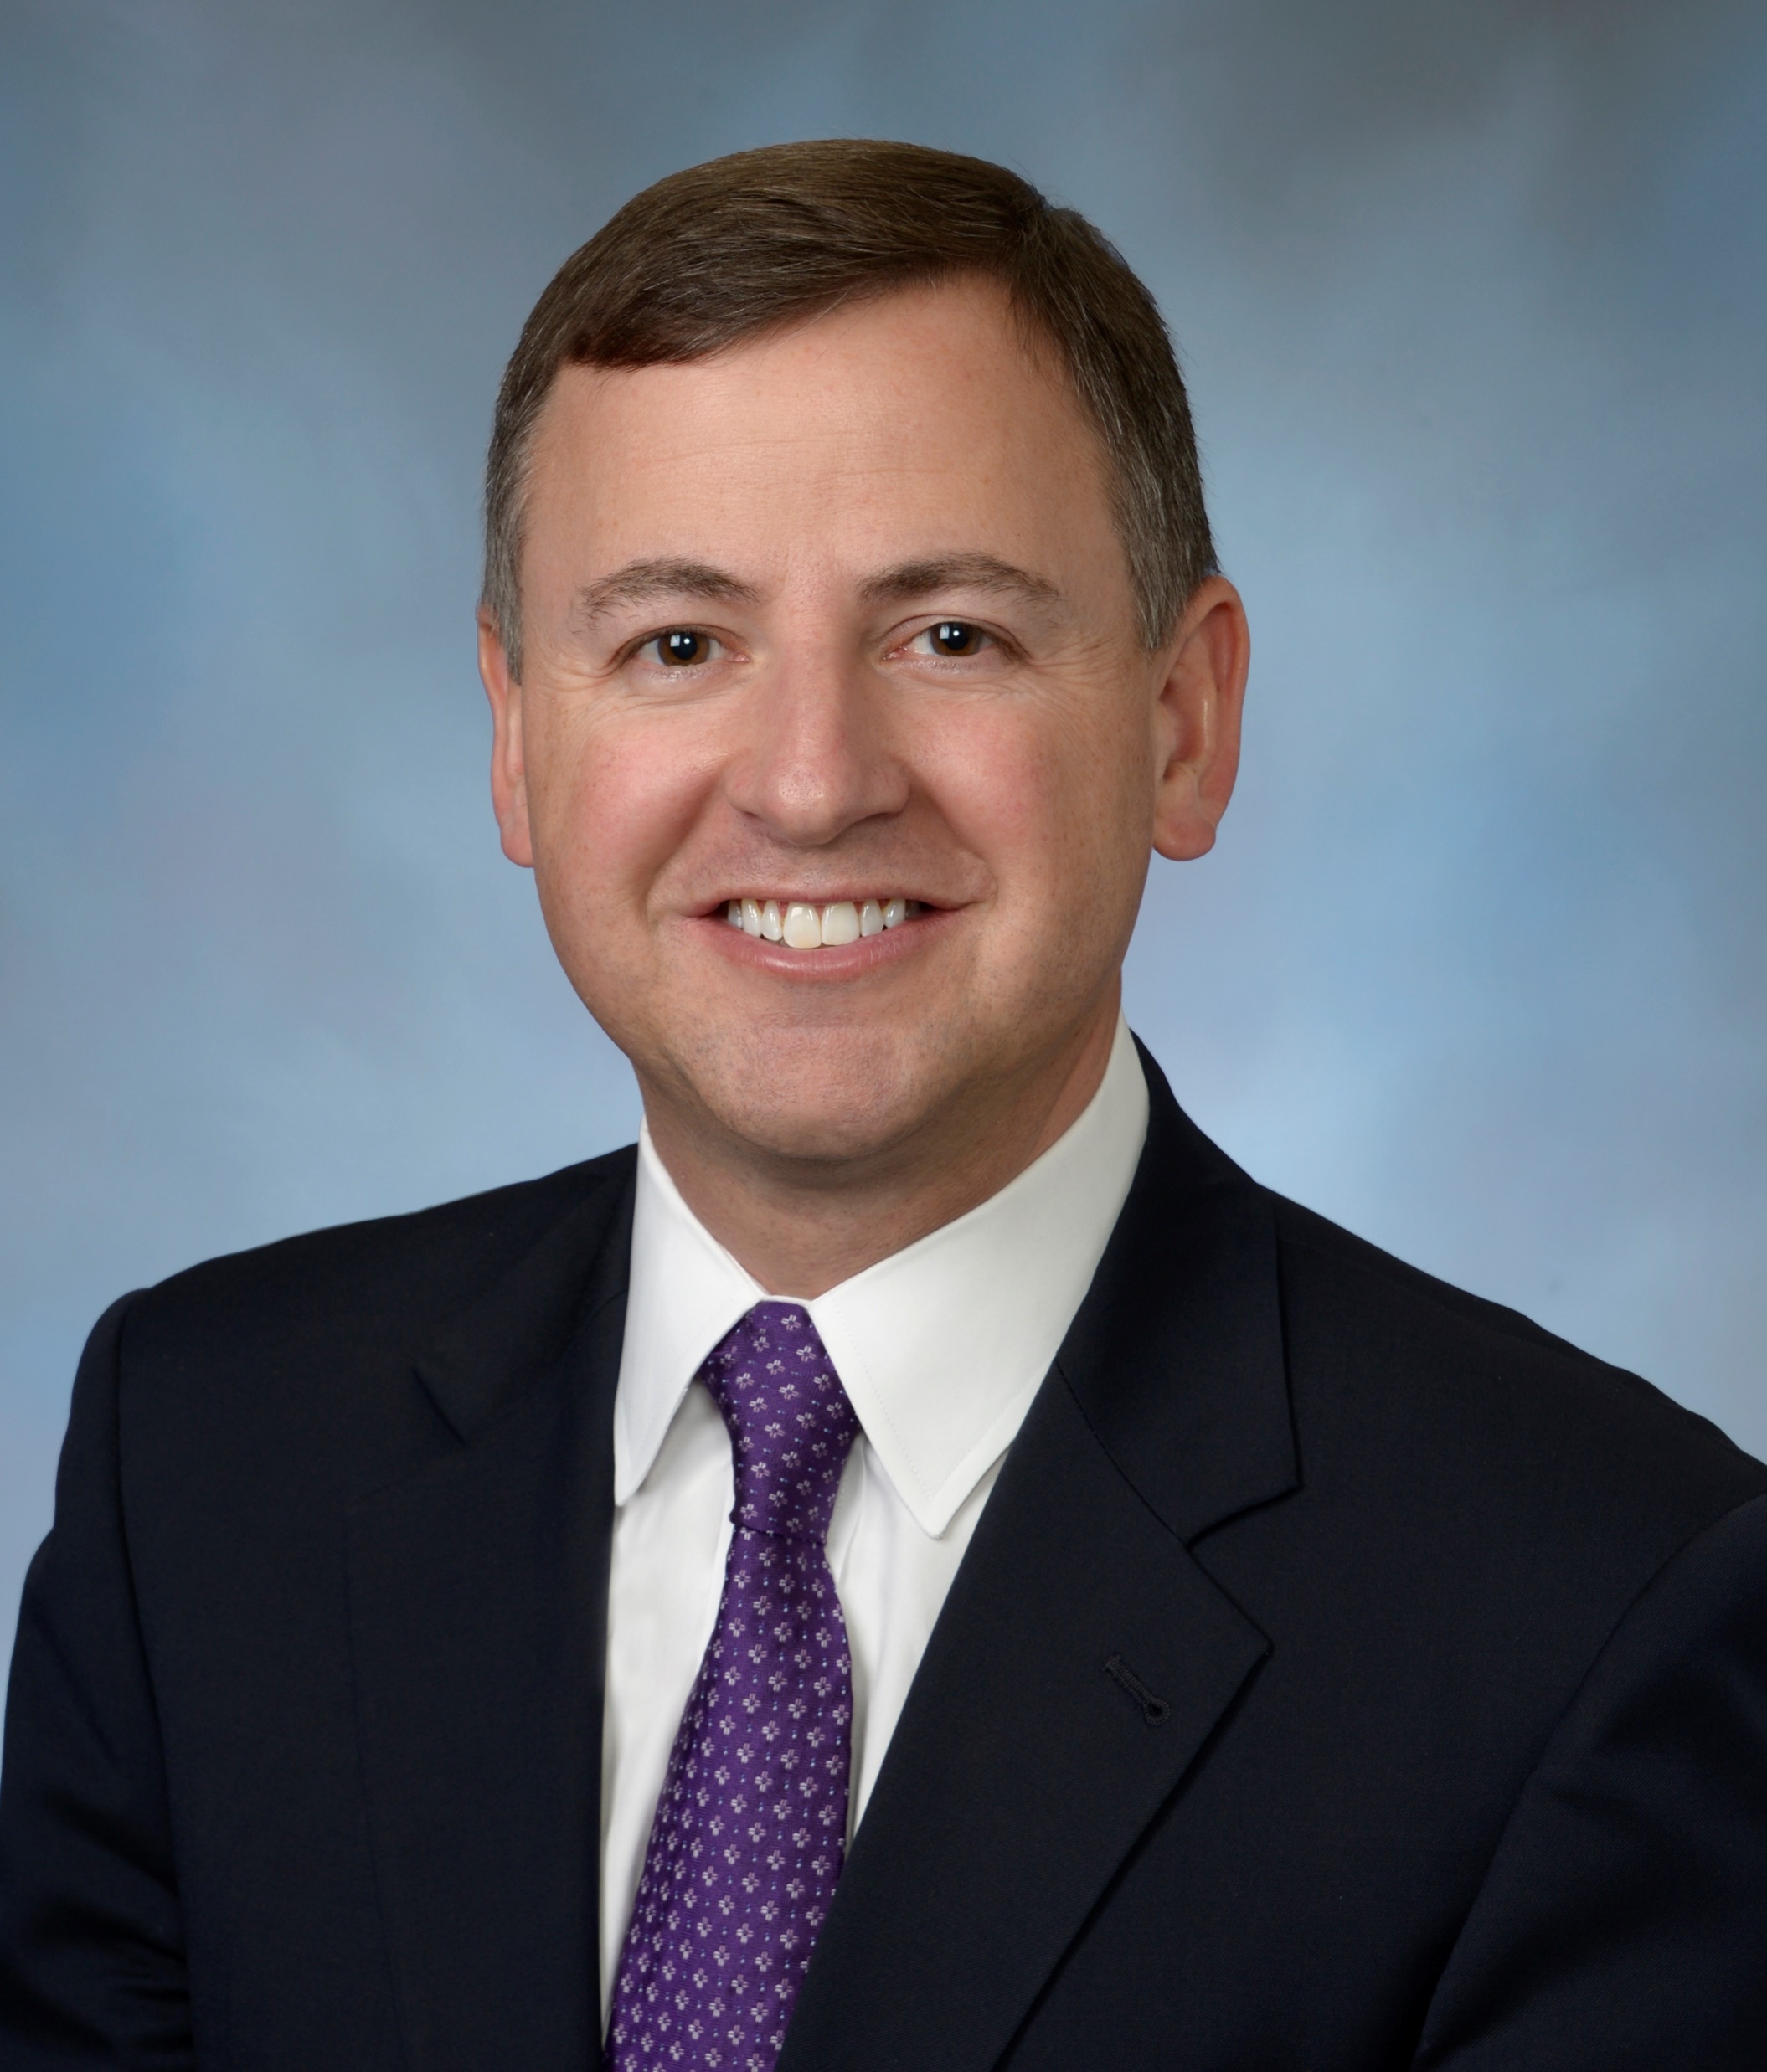
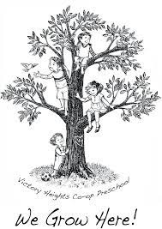
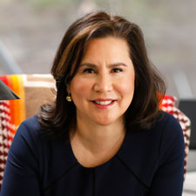
Strengthening Connections
Notes:
Strengthened relationships with neighboring Councils and representatives

Slide 20
Notes:
Created phone and voicemail line for community members

Slide 21
Building Community

Slide 22
Neighborhood Improvements
Two new park benches
Sanican at the Playground
Neighbor Labor
Invasive Species (blackberry) removals – both volunteers + SDOT
NE 106th Embankment clean-up
Significant communications and research around Park improvements
Significant communications and research around traffic calming
November North Seattle Sock Drive

Slide 23
Strengthening Community Connections
Show the Love Valentine’s Day card campaign;
Community Connections;
Community Interest Groups;
COVID Vaccination Drive;
Victory Heights Voices

Slide 24
Coming Soon in 2022…

Slide 25
Traffic Calming
Notes:
Continued focus on traffic calming

Slide 26
New Website
Notes:
Developing a website in tandem with blog

Slide 27
Recruit & Energize Volunteers

Slide 28
Calendar of Events
Notes:
Developing an annual calendar of monthly events

Slide 29
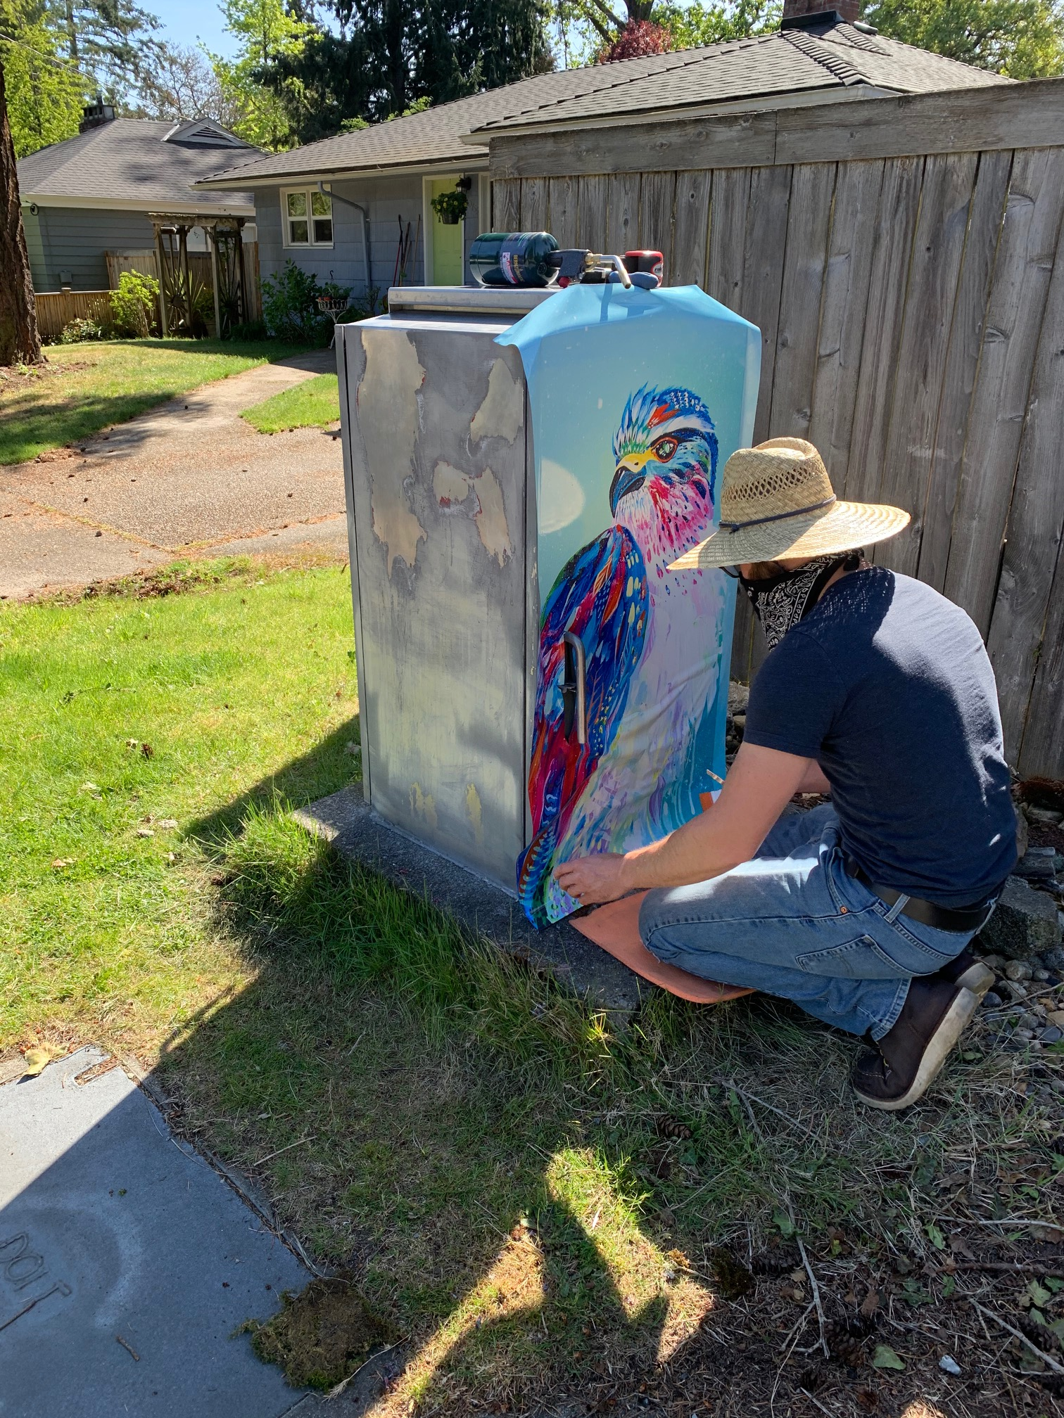
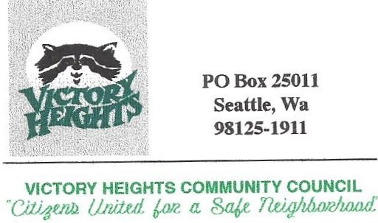
Logo and Branding
Notes:
Developing a new logo and brand

Slide 30
Food Truck Fridays
Notes:
Bringing back Food Truck Friday

Slide 31
Sharing Goals to Recruit Support
Notes:
Developing list of financial needs to give easier opportunities for community members to support our goals and initiatives

Slide 32
Victory Heights Co-Op Preschool
Notes:
Strengthen relationship and ways to support

Slide 33
Strengthen Local Business Relationships

Slide 34
Playground Toy Drive

Slide 35
And So Much More!

Slide 36
Questions?

